Slide 1
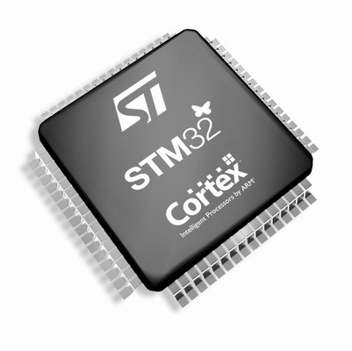
The Cortex-M3/M4 Embedded Systems: Cortex-M3/M4 Exceptions and Interrupts
Refer to Chapter 7, 8, 10, 12 in the reference book
“The Definitive Guide to ARM Cortex-M3 and Cortex-M4 Processors”

Slide 2
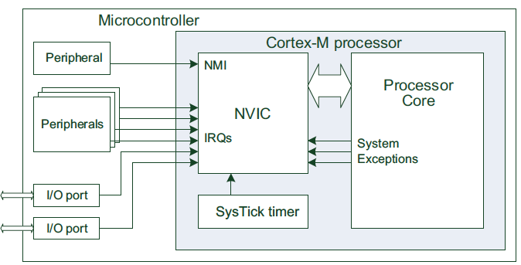
Exceptions
Exceptions are numbered 1 to 15 for system exceptions and the rest 240 for external interrupt inputs.(Total 256 entries in vector table.)
Most of the exceptions have programmable priority, and a few have fixed priority.
The value of the current running exception is indicated by the special register IPSR or from the NVIC’s Interrupt Control State Register.
An enabled exception can be pended (which means it cannot be carried out immediately due to some reasons)

Slide 3
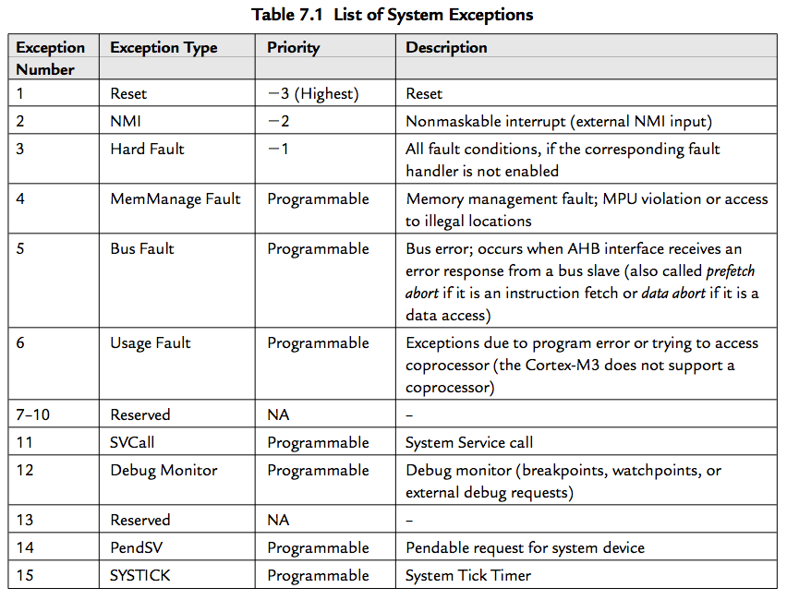
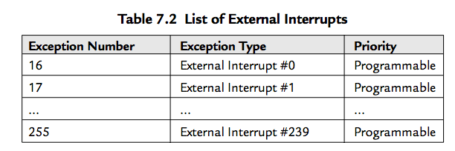
List of Exceptions
Note that here the interrupt number (e.g., Interrupt #0) refers to the interrupt inputs to the Cortex-M3/M4 NVIC

Slide 4
Exception Priority
Whether and when an exception can be carried out can be affected by the priority of the exception
A higher-priority (smaller number in priority level) exception can preempt (抢占) a lower-priority exception
Reset, NMI, and hard fault have fixed highest-priority levels, i.e., -3, -2, and -1
The Cortex-M3/M4 supports 256 levels of programmable priority
The reduction of priority levels can be implemented by cutting out several lowest bits of the priority configuration register

Slide 5

Priority-Level Configuration Register
3 bits of priority level
Bit 7 | Bit 6 | Bit 5 | Bit 4 | Bit 3 | Bit 2 | Bit 1 | Bit 0
Implemented |  |  | Not implemented, read as zero
4 bits of priority level
Bit 7 | Bit 6 | Bit 5 | Bit 4 | Bit 3 | Bit 2 | Bit 1 | Bit 0
Implemented |  |  |  | Not implemented, read as zero
The minimum width of the implemented priority register is 3 bits.

Slide 6
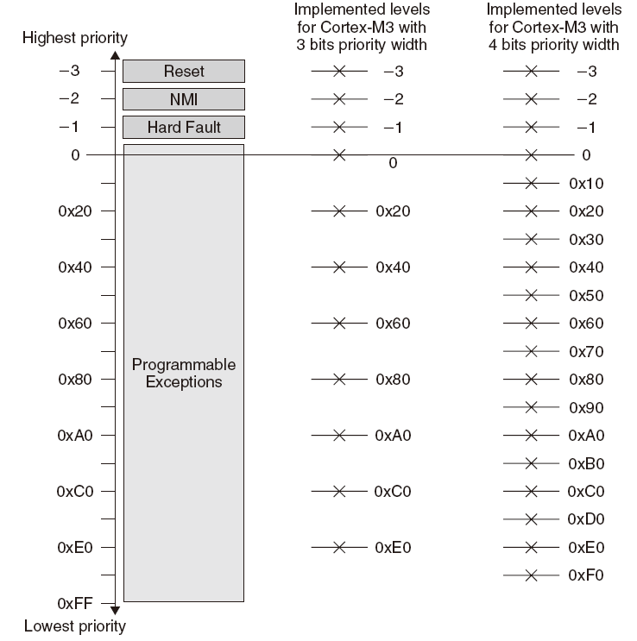
Available Priority Levels with 3-Bit or 4-Bit Priority Width

Slide 7
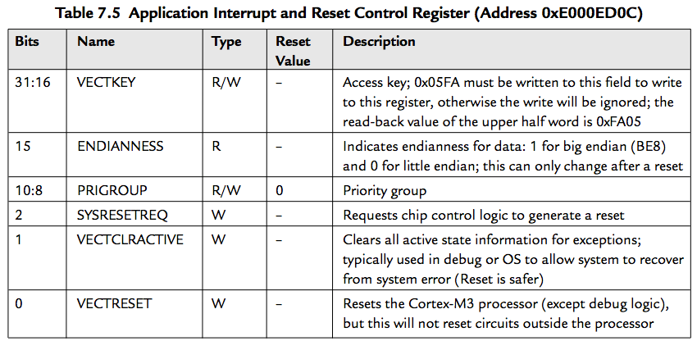
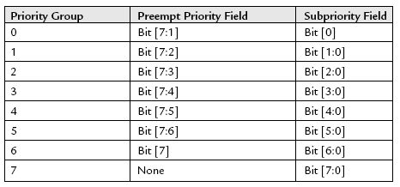
Priority-Level Configuration Register Organization
This register is further divided into two parts: preempt priority and subpriority.
The organization of the Priority-Level Configuration Register can be defined using a priority group bit field in the Application Interrupt and Reset control Register
Group (preempt) priority: an interrupt or exception with a higher preempt priority can preempt one with a lower preempt priority
Subpriority: defines the order when multiple interrupts or exceptions with the same preempt priority occur at the same time
When two interrupts with exactly the same group priority level and sub-priority level, the interrupt with the smaller exception number has higher priority (e.g., IRQ #0 has higher priority than IRQ #1)

Slide 8
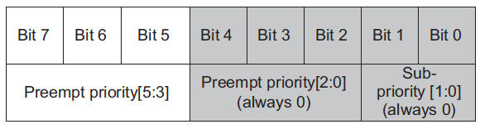
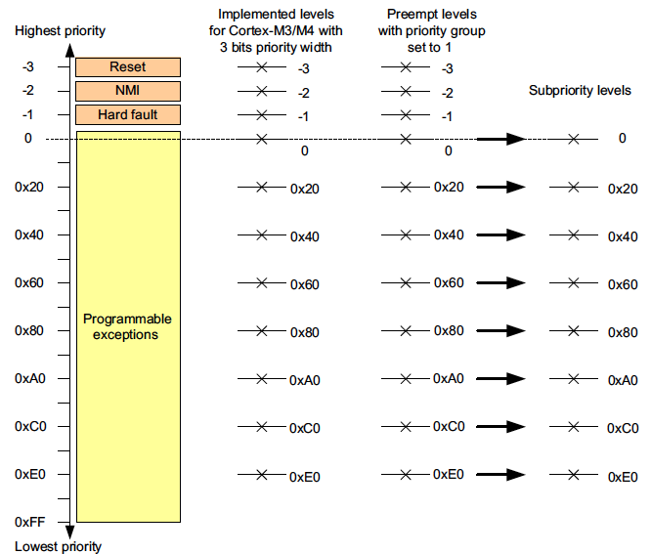

Deciding Preempt priority and Subpriority Levels

Slide 9
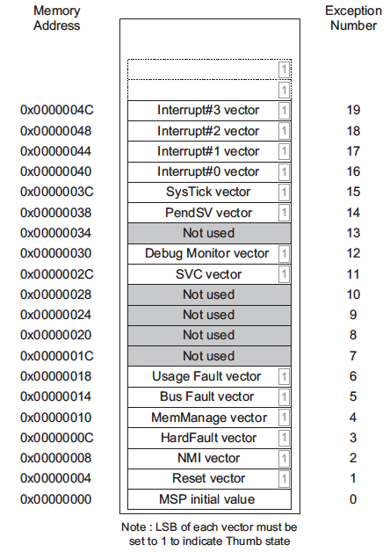
Vector Table
The processor will need to locate the starting address of the exception handler when an exception is being handled. This information is stored in the vector table.
In a minimal setup, the vector table needs to provide the initial MSP value and the Reset vector for the system to boot up.
In addition, depending on your application, you might also need to include the NMI vector and the HardFault vector for error handling.

Slide 10
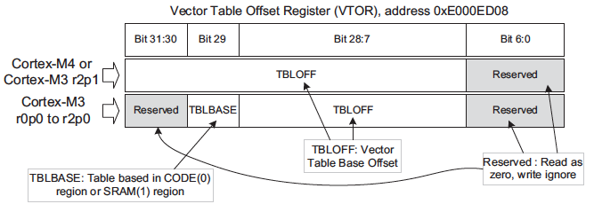
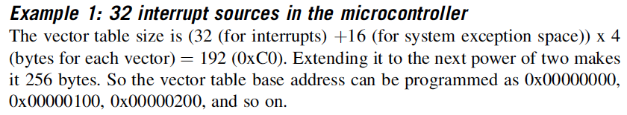
Vector Table Relocation
In Cortex-M3 r2p0 or older versions, the vector table can only be in the CODE region or the SRAM region. This restriction is removed from Cortex-M3 r2p1 and Cortex-M4.
The base address of the new vector table must be aligned to the size of the vector table extended to the next larger power of 2.

Slide 11
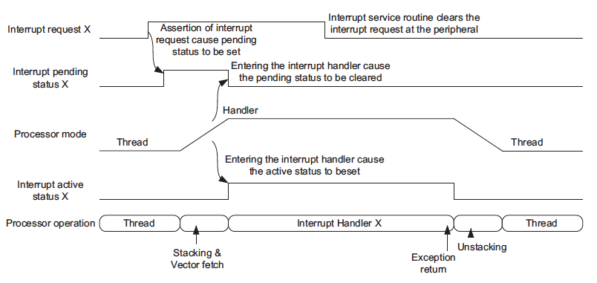
Interrupt Inputs and Pending Behaviors
An interrupt request can be accepted by the processor if:
The pending status (hold by a register) of this interrupt is set
The interrupt is enabled (controlled by an interrupt masking register)
The priority of the interrupt is higher than the current level
Otherwise, the interrupt would be pended until the other interrupt handler is finished, or when the interrupt masking is cleared
When the interrupt is being served, the pending status of the interrupt is cleared automatically and it is in the active state (hold by a register).
With the pending status of an interrupt, NVIC supports both pulsed interrupt requests and high level interrupt request

Slide 12
Interrupt Inputs and Pending Behaviors
you can clear a pending interrupt or use software to pend a new interrupt by setting the pending register
If the pending status is cleared (the pending status of the interrupt can be accessed in the NVIC and is writable) before the processor starts responding to the pended interrupt, the interrupt can be canceled
Interrupt Pending Cleared Before Processor Takes Action

Slide 13
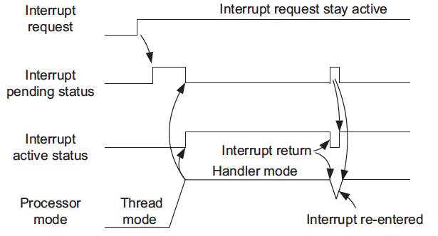
Interrupt Inputs and Pending Behaviors
If an interrupt source continues to hold the interrupt request signal active, the interrupt will be pended again at the end of the interrupt service routine.
Continuous Interrupt Request Pends Again After Interrupt Exit

Slide 14
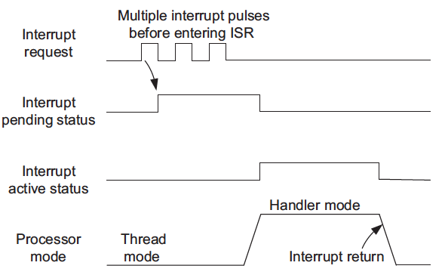
Interrupt Inputs and Pending Behaviors
If an interrupt is pulsed several times before the processor starts processing it, it will be treated as one single interrupt request.
Interrupt Pending Only Once, Even with Multiple Pulses Before the Handler

Slide 15
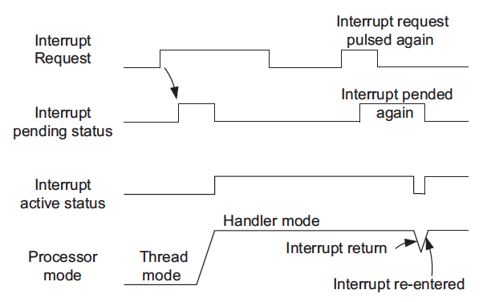
Interrupt Inputs and Pending Behaviors
If an interrupt is de-asserted and then pulsed again during the interrupt service routine, it will be pended again.
Interrupt Pending Occurs Again During the Handler

Slide 16
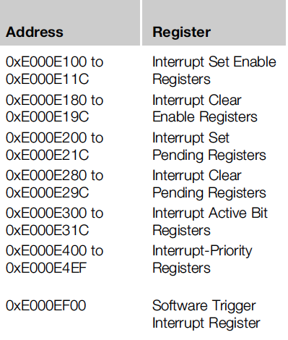
Interrupt Control
Registers in NVIC related to interrupt control
Most of the interrupt control/ status registers are accessible only in privileged mode (access via MRS and MSR) in word, half word, or byte transfers
Except the Software Trigger Interrupt Register (STIR), which can be set up to be accessible in user mode
In addition, a few other interrupt-masking registers are also involved in the interrupt control.

Slide 17
Interrupt Enable and Clear Enable
The Interrupt Enable register is programmed via two addresses.
To set the enable bit, write 1 to the SETENA register address;
Write 1 to set bit to 1; write 0 has no effect; read value indicates the current status
To clear the enable bit, write 1 to the CLRENA register address.
Write 1 to clear bit to 0; write 0 has no effect; read value indicates the current status
SETENA/CLRENA registers are 32-bit, each bit represents one interrupt input
If there are more than 32 external interrupts (up to 240), there would be more than one SETENA/CLRENA registers.
SETENA: 0xE000E100--0xE000E11C
CLRENA: 0xE000E180-0xE000E19C

Slide 18
Interrupt Enable and Clear Enable
Interrupt Set Enable Registers and Interrupt Clear Enable Registers
Name | Type | Address | Reset Value | Description
SETENA0 | R/W | 0xE000E100 | 0 | Enable for external interrupt #0-31
SETENA1 | R/W | 0xE000E104 | 0 | Enable for external interrupt #32-63
… | … | … | … | …
SETENA7 | R/W | 0xE000E11C | 0 | Enable for external interrupt #224-239
CLRENA0 | R/W | 0xE000E180 | 0 | Clear Enable for external interrupt #0-31
CLRENA1 | R/W | 0xE000E184 | 0 | Clear Enable for external interrupt #32-63
… | … | … | …
CLRENA7 | R/W | 0xE000E19C | 0 | Clear Enable for external interrupt #224-239

Slide 19
Interrupt Pending and Clear Pending
The interrupt-pending status can be programmed via two addresses.
To set the pending bit, write 1 to the Interrupt Set Pending (SETPEND) register;
Write 1 to set bit to 1; write 0 has no effect; read value indicates the current status
To clear the pending bit, write 1 to the Interrupt Clear Pending (CLRPEND) register.
Write 1 to clear bit to 0; write 0 has no effect; read value indicates the current status
SETPEND/ CLRPEND registers are 32-bit, each bit represents one interrupt input
User can set the certain bit of SETPEND to enter its handler by software.
If there are more than 32 external interrupts (up to 240), there would be more than one SETPEND/ CLRPEND registers.
SETPEND: 0xE000E200-0xE000E21C
CLRPEND: 0xE000E280-0xE000E29C

Slide 20
Interrupt Pending and Clear Pending
Interrupt Set Pending Registers and Interrupt Clear Pending Registers
Name | Type | Address | Reset Value | Description
SETPEND0 | R/W | 0xE000E200 | 0 | Pending for external interrupt #0-31
SETPEND1 | R/W | 0xE000E204 | 0 | Pending for external interrupt #32-63
… | … | … | … | …
SETPEND7 | R/W | 0xE000E21C | 0 | Pending for external interrupt #224-239
CLRPEND0 | R/W | 0xE000E280 | 0 | Clear pending for external interrupt #0-31
CLRPEND1 | R/W | 0xE000E284 | 0 | Clear pending for external interrupt #32-63
… | … | … | …
CLRPEND7 | R/W | 0xE000E29C | 0 | Clear pending for external interrupt #224-239

Slide 21
Priority
Each external interrupt has an associated priority-level register (a width of 3-8 bits)
To find out the number of bits implemented for interrupt priority-level registers, write 0xFF to one of the priority-level registers, then read it back and see how many bits are set.
Interrupt Priority-Level Registers (0xE000E400-0xE000E4EF)
Name | Type | Address | Reset Value | Description
PRI_0 | R/W | 0xE000E400 | 0 (8-bit) | Priority-level external interrupt #0
PRI_1 | R/W | 0xE000E401 | 0 (8-bit) | Priority-level external interrupt #1
… | … | … | … | ..
PRI_239 | R/W | 0xE000E4EF | 0 (8-bit) | Priority-level external interrupt #239

Slide 22
Active Status
Each external interrupt has an active status bit.
When the processor starts the interrupt handler, the bit is set to 1 and cleared when the interrupt return is executed.
Interrupt Active Status Registers (0xE000E300-0xE000E31C)
Name | Type | Address | Reset Value | Description
ACTIVE0 | R | 0xE000E300 | 0 | Active status for external interrupt #0-31
ACTIVE1 | R | 0xE000E304 | 0 | Active status for external interrupt #32-63
… | … | … | … | …
ACTIVE7 | R | 0xE000E31C | 0 | Active status for external interrupt #224-239

Slide 23
Software Interrupts
Software interrupts can be generated by using:
1. The SETPEND register
2. The Software Trigger Interrupt Register (STIR)
Software Trigger Interrupt Register (0xE000EF00)
Bits | Name | Type | Reset Value | Description
8:0 | INTID | W | – | Writing the interrupt number sets the pending bit of the interrupt; for example, write 0 to pend external interrupt #0
System exceptions (NMI, faults, PendSV, and so on) cannot be pended using STIR.
STIR can be accessed in user level when the bit 1 (USERSETMPEND) of the NVIC Configuration Control Register is set.

Slide 24
Fault Exceptions: Bus Faults
Bus faults are produced when an error response is received during a transfer on the AHB interfaces.
Bus fault due to:(BFSR Register records the status)
Prefetch abort (Instruction prefetch)
Data abort (data read/write)
Stacking error (stack PUSH in the beginning of interrupt processing)
Unstacking error (stack POP at the end of interrupt processing)
Reading of an interrupt vector address error (when the processor starts the interrupt-handling sequence)

Slide 25
Handling Bus Faults
If
1. The bus fault handler is enabled (BUSFAULTENA bit in the System Handler Control and State Register in the NVIC).
2. No other exceptions with the same or higher priority are running.
Then
The bus fault handler will be executed.
Else if
At the same time the core receives another exception handler with higher priority.
Then
The bus fault exception will be pending.
Note: if the bus fault handler is not enabled or when the bus fault happens in an exception handler that has the same or higher priority than the bus fault handler, the hard fault handler will be executed instead

Slide 26
Checking on Bus Faults
The NVIC has a number of fault status registers. One of them is the Bus Fault Status Register (BFSR).
Bus Fault Status Register (0xE000ED29)
Bits | Name | Type | Reset Value | Description
7 | BFARVALID | — | 0 | Indicates BFAR is valid
6:5 | — | — | — | —
4 | STKERR | R/Wc | 0 | Stacking error
3 | UNSTKERR | R/Wc | 0 | Unstacking error
2 | IMPREISERR | R/Wc | 0 | Imprecise data access violation
1 | PRECISERR | R/Wc | 0 | Precise data access violation
0 | IBUSERR | R/Wc | 0 | Instruction access violation

Slide 27
Fault Exceptions: Memory Management Faults
Common memory manage faults include:
Access to memory regions not defined in MPU setup.
Execute code from nonexecutable memory regions.
Writing to read-only regions.
An access in the user state to a region defined as privileged access only.

Slide 28
Handling Memory Management Faults
if
1. The memory manage fault handler is enabled (set the MEMFAULTENA bit in the System Handler Control and State Register in the NVIC).
2. No other exceptions with the same or higher priority are running.
Then
The memory manage fault handler will be executed.
Else if
At the same time the core receives another exception handler with higher priority.
Then
The memory manage fault exception will be pending.
Note: If the processor is already running an exception handler with same or higher priority or if the memory management fault handler is not enabled, the hard fault handler will be executed instead.

Slide 29
Checking on Memory Management Faults
The NVIC contains a Memory Management Fault Status Register (MFSR) to indicate the cause of the memory management fault.
Memory Management Fault Status Register (0xE000ED28)
Bits | Name | Type | Reset Value | Description
7 | MMARVALID | — | 0 | Indicates the MMAR is valid
6:5 | — | — | — | —
4 | MSTKERR | R/Wc | 0 | Stacking error
3 | MUNSTKERR | R/Wc | 0 | Unstacking error
2 | — | — | — | —
1 | DACCVIOL | R/Wc | 0 | Data access violation
0 | IACCVIOL | R/Wc | 0 | Instruction access violation

Slide 30
Fault Exceptions: Usage Faults
Usage faults can be caused by:
Undefined instructions
Coprocessor instructions (the Cortex-M3 processor does not support a coprocessor)
Trying to switch to the ARM state (This can happen if you load a new value to PC with the LSB equal to 0)
Invalid interrupt return (Link Register contains invalid/incorrect values)
Unaligned memory accesses using multiple load or store instructions
It is possible, by setting up certain control bits in the NVIC, to generate usage faults for:
1. Divide by zero
2. Any unaligned memory accesses

Slide 31
Handling Usage Faults
When a usage fault occurs
if
1. The usage fault handler is enabled (set the USGFAULTENA bit in the System Handler Control and State Register in the NVIC).
2. No other exceptions with the same or higher priority are running.
Then
The usage fault handler will be executed.
Else if
At the same time the core receives another exception handler with higher priority.
Then
The usage fault exception will be pending.
Note: If the processor is already running an exception handler with same or higher priority or if the usage fault handler is not enabled, the hard fault handler will be executed instead.

Slide 32
Checking on Usage Faults
The NVIC provides a Usage Fault Status Register (UFSR) for the usage fault handler to determine the cause of the fault.
Usage Fault Status Register (0xE000ED2A)
Bits | Name | Type | Reset Value | Description
9 | DIVBYZERO | R/Wc | 0 | Indicates a divide by zero has taken place (can be set only if DIV_0_TRP is set)
8 | UNALIGNED | R/Wc | 0 | Indicates that an unaligned access fault has taken place
7:4 | — | — | — | —
3 | NOCP | R/Wc | 0 | Attempts to execute a coprocessor instruction
2 | INVPC | R/Wc | 0 | Attempts to do an exception with a bad value in the EXC_RETURN number
1 | INVSTATE | R/Wc | 0 | Attempts to switch to an invalid state (e.g., ARM)
0 | UNDEFINSTR | R/Wc | 0 | Attempts to execute an undefined instruction

Slide 33
Fault Exceptions: Hard Faults
The hard fault handler can be caused by:
1. Usage faults, bus faults, and memory management faults if their handler cannot be executed
2. A bus fault during vector fetch
Hard Fault Status Register (0xE000ED2C)
Bits | Name | Type | Reset Value | Description
31 | DEBUGEVT | R/Wc | 0 | Indicates hard fault is triggered by debug event
30 | FORCED | R/Wc | 0 | Indicates hard fault is taken because of bus fault, memory management fault, or usage fault
29:2 | — | — | — | —
1 | VECTBL | R/Wc | 0 | Indicates hard fault is caused by failed vector fetch
0 | — | — | — | —

Slide 34
Dealing with Faults
In a real system, after the cause of a fault is determined (use the Fault Status Registers [FSRs]), the software will have to decide what to do next.
If OS exists, the OS could terminates the offending tasks;
Otherwise,
1. Reset: Using the VECTRESET control bit in the Application Interrupt and Reset Control Register in the NVIC (reset the processor core but not the whole chip [using the SYSRESETREQ instead]).
2. Recover: It is possible to resolve the problem that caused the fault exception.
Note: The FSRs retain their status until they are cleared manually by using a write-to-clear mechanism (clear by writing 1 to the bits that need to be cleared) in fault handlers

Slide 35
SVC and PendSV
SVC (System Service Call) and PendSV (Pended System Call) are two exceptions targeted at software and operating systems.
SVC
SVC is for generating system function calls
SVC is exception type 11, and has a programmable priority level
SVC is generated using the SVC instruction
SVC #0x3 ; Call SVC function 3
SVC cannot be pended (The SVC handler must be executed after the SVC instruction)
Example:
Instead of allowing user programs to directly access hardware, operating system may provide access to hardware via an SVC.
SVC can make software more portable because the user application does not need to know the programming details of the hardware.

Slide 36
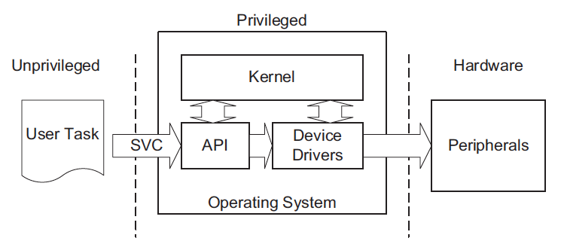
SVC
SVC as a Gateway for OS Functions
Note: if the SVC instruction is accidentally used in an exception handler that has the same or higher priority than the SVC exception itself, it will cause the HardFault exception handler to execute. For example, you cannot use SVC inside an SVC handler.

Slide 37
PendSV
PendSV (Pended System Call) works with SVC in the OS.
PendSV is generated by setting its pending status by writing to the Interrupt Control and State Register (ICSR)
Example: A typical use of PendSV is context switching (switching between tasks).
A system with only two tasks, and a context switch can be triggered by SYSTICK exceptions.

Slide 38
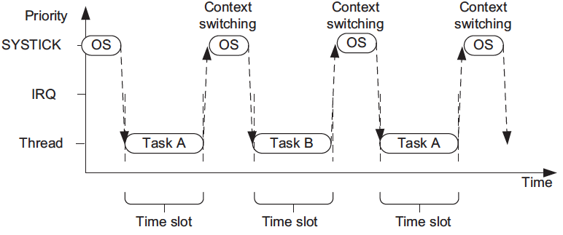
A Simple Scenario Using SYSTICK to Switch Between Two Tasks

Slide 39
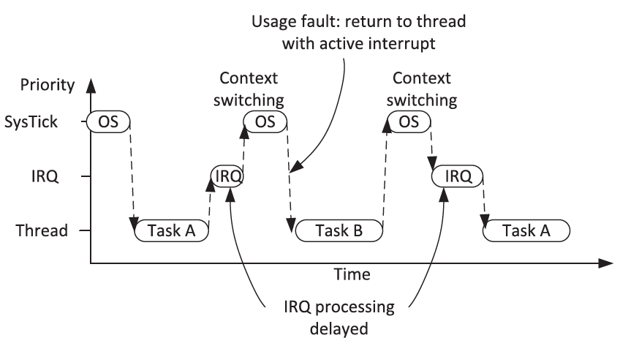
Problems at Context Switching at the IRQ
If an interrupt request takes place before the SYSTICK exception, the SYSTICK exception will preempt the IRQ handler. What’s the problem?
One solution: context switching can happen only if the OS detects that none of the IRQ handlers are being executed. What’s the problem?

Slide 40
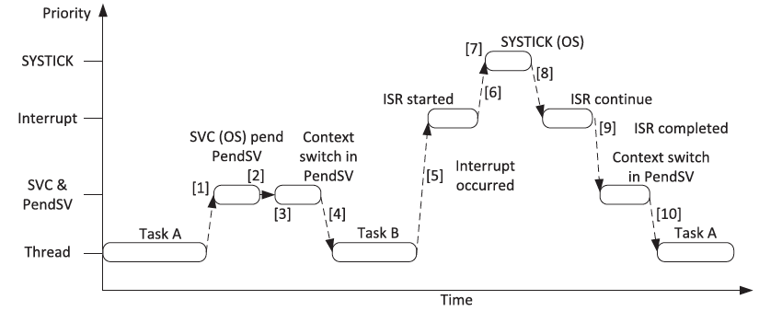
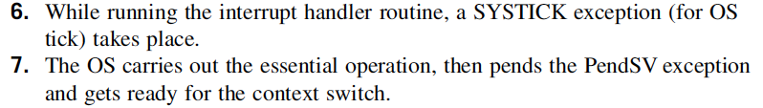
Using PendSV for Context Switching
Using PendSV which is programmed at lowest priority level

Slide 41
PRIMASK and FAULTMASK Special Registers
The PRIMASK register disables all exceptions except NMI and hard fault by changing the current priority level to 0
When PRIMASK is set, if a fault takes place, the hard fault handler will be executed)
The FAULTMASK register changes the effective current priority level to -1 so that even the hard fault handler is blocked
FAULTMASK is cleared automatically upon exiting the exception handler.
They are programmable using MRS and MSR instructions in privileged modes.
Example:
MOV R0, #1
MSR PRIMASK, R0 ; Write 1 to PRIMASK to disable all interrupts
MOV R0, #0
MSR PRIMASK, R0 ; Write 0 to PRIMASK to allow interrupts

Slide 42
The BASEPRI Special Register
The BASEPRI register disables interrupts with priority equal or lower than a certain level.
Example:
MOV R0, #0x60
MSR BASEPRI, R0 ;Disable interrupts with priority 0x60-0xFF
Write 0 to BASEPRI to turn off the masking:
MOV R0, #0x0
MSR BASEPRI, R0 ; Turn off BASEPRI masking
The BASEPRI register can also be accessed using the BASEPRI_MAX register name.

Slide 43
The BASEPRI Special Register
Using BASEPRI_MAX as a register, it can only be changed to a higher priority level.
Example:
MOV R0, #0x60
MSR BASEPRI_MAX, R0 ; Disable interrupts with priority 0x60, ; 0x61,..., etc
MOV R0, #0xF0
MSR BASEPRI_MAX, R0 ; This write will be ignored because
; it is lower level than 0x60
MOV R0, #0x40
MSR BASEPRI_MAX, R0 ; This write is allowed and change
; the masking level to 0x40
To change to a lower masking level or disable the masking, the BASEPRI register name should be used

Slide 44
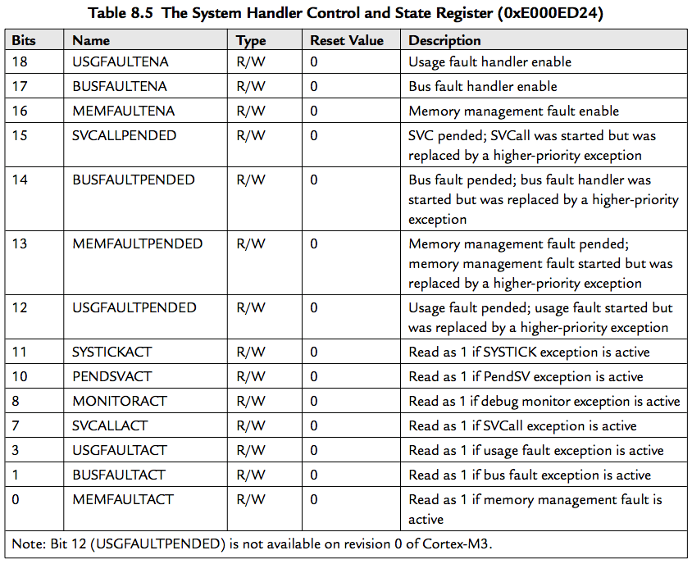
Configuration Registers for Other Exceptions
Usage faults, memory management faults, and bus fault exceptions are enabled by the System Handler Control and State Register.

Slide 45
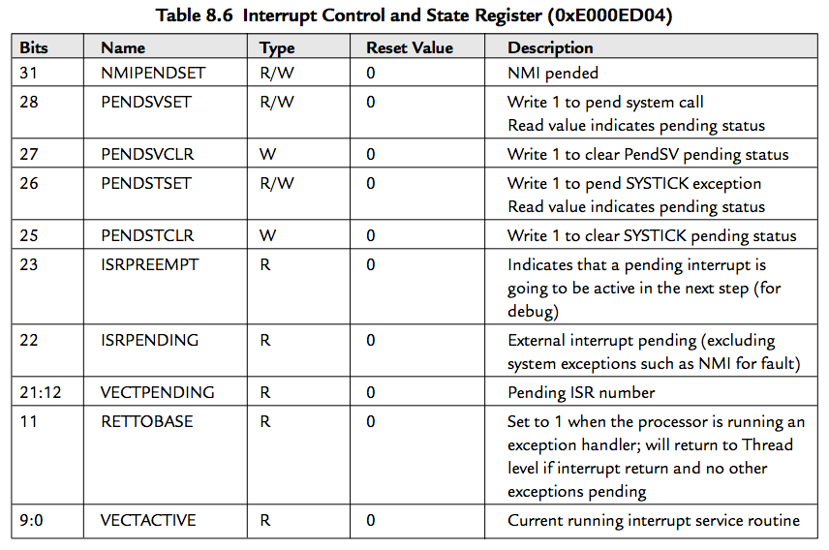
Interrupt Control and State Register (0xE000ED04)
Pending for NMI, the SYSTICK timer, and PendSV is programmable via the Interrupt Control and State Register

Slide 46
Example Procedures in Setting Up an Interrupt
1. Set up the priority group register (group 0 by default).
2. Setup the hard fault and NMI handlers to a new vector table location if vector table relocation is required.
3. Set up the Vector Table Offset register if needed.
4. Set up the interrupt vector for the interrupt：[read the Vector Table Offset register and] calculate the correct memory location for the interrupt handler.
5. Set up the priority level for the interrupt.
6. Enable the interrupt.
Example in assembly:
LDR R0, =0xE000ED0C ; Application Interrupt and Reset ; Control Register (see Table 7.5)
LDR R1, =0x05FA0500 ; Priority Group 5 (2/6)
STR R1, [R0] ; Set Priority Group

Slide 47
Example Procedures in Setting Up an Interrupt
...
MOV R4, #8 ; Vector Table in ROM
LDR R5, =(NEW_VECT_TABLE+8)
LDMIA R4!, {R0-R1} ; Read vectors address for NMI and Hard Fault
STMIA R5!, {R0-R1} ; Copy vectors to new vector table
...
LDR R0, =0xE000ED08 ; Vector Table Offset Register
LDR R1, =NEW_VECT_TABLE
STR R1, [R0] ; Set vector table to new location
...
LDR R0, =IRQ7_Handler ; Get starting address of IRQ#7 handler
LDR R1, =0xE000ED08 ; Vector Table Offset Register
LDR R1, [R1]
ADD R1, R1, #(4*(7+16)) ; Calculate IRQ#7 handler vector address
STR R0, [R1] ; Setup vector for IRQ#7
...
LDR R0, =0xE000E400 ; External IRQ priority base

Slide 48
Example Procedures in Setting Up an Interrupt
MOV R1, #0xC0
STRB R1, [R0,#7] ; Set IRQ#7 priority to 0xC0
...
LDR R0, =0xE000E100 ; SETEN register
MOV R1, #(1<<7) ; IRQ#7 enable bit (value 0x1 shifted by 7 bits)
STR R1, [R0] ; Enable the interrupt

Slide 49
Interrupt Behavior
When an exception takes place, a number of things happen:
Stacking (pushing eight registers’ contents to stack)
Vector fetch (reading the exception handler starting address from the vector table)
Update of the stack pointer, link register, and program counter

Slide 50
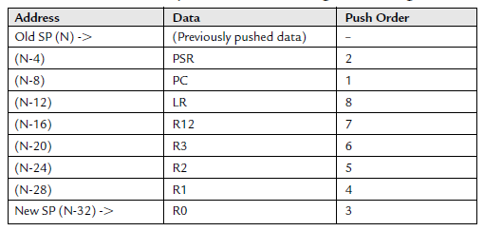
Stacking
When an exception takes place, the registers PC, PSR, R0–R3, R12, and LR are pushed to the stack
If the code that is running uses the PSP, the process stack will be used; if the code that is running uses the MSP, the main stack will be used
The main stack will always be used during the handler

Slide 51
Vector Fetches
While the data bus is busy stacking the registers, the instruction bus fetches the exception vector (the starting address of the exception handler) from the vector table.
Since the stacking and vector fetch are performed on separate bus interfaces, they can be carried out at the same time

Slide 52
Register Updates
After the stacking and vector fetch are completed, the exception vector will start to execute.
On entry of the exception handler, a number of registers will be updated:
SP: The Stack Pointer (either the MSP or the PSP)
PSR: The IPSR (the lowest part of the PSR) will be updated to the new exception number
PC: This will change to the vector handler as the vector fetch completes
LR: The LR will be updated to a special value called EXC_RETURN, used to store the states of the interrupted program (i.e., which stack used, instruction state, thread/handler mode)

Slide 53
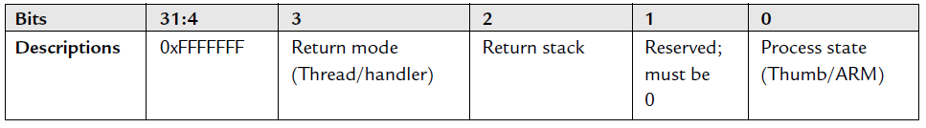
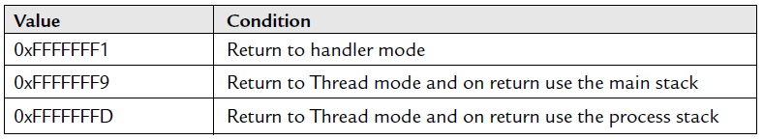
LR Update
When entering an exception handler, the LR is updated to a special value called EXC_RETURN (updated automatically)
Therefore, the 0xFFFFFFF0–0xFFFFFFFF memory range is reserved only for EXC_RETURN (it is in a non-executable region anyway)

Slide 54
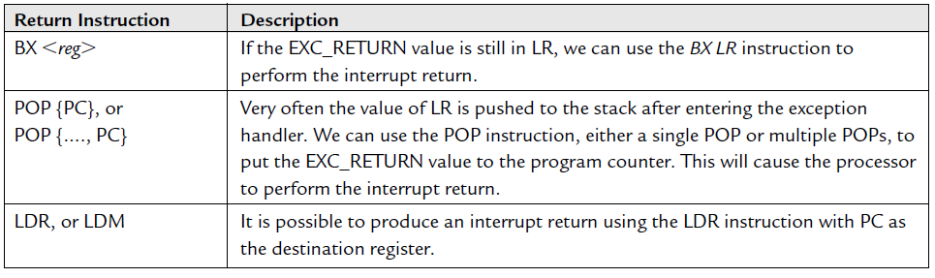
Exception Exits
At the end of the exception handler, an exception exit is required to restore the system status so that the interrupted program can resume normal execution.
When the EXC_RETURN is loaded into the PC at the end of the exception handler execution, the processor performs an exception return sequence
There are three ways to trigger the interrupt return sequence:

Slide 55
Exception Exits
When the interrupt return instruction is executed, the following processes are carried out:
Un-stacking: The registers pushed to the stack will be restored
NVIC register update: The active bit of the exception will be cleared. For external interrupts, if the interrupt input is still asserted, the pending bit will be set again, causing it to reenter the interrupt handler

Slide 56
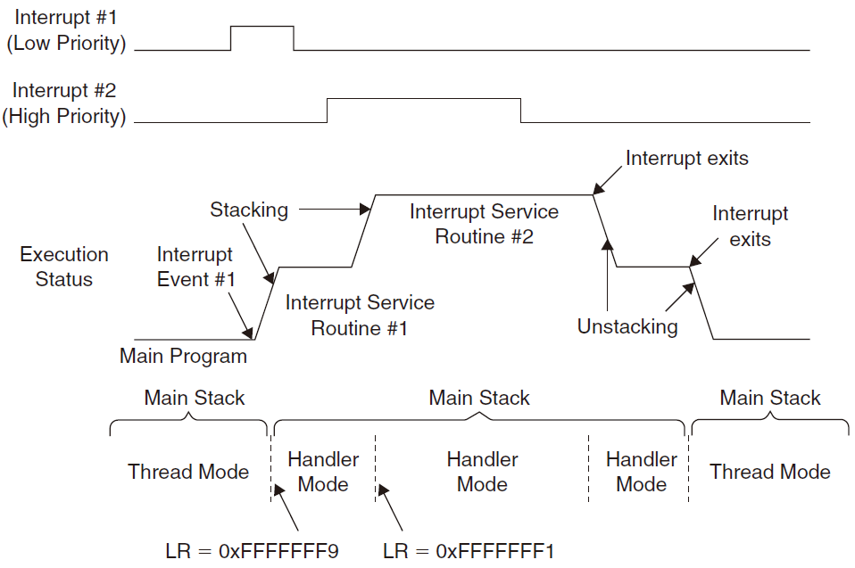
LR Set to EXC_RETURN Example 1

Slide 57
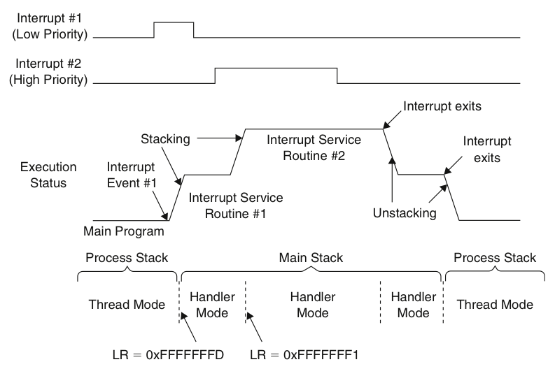
LR Set to EXC_RETURN Example 2

Slide 58
Nested Interrupts
Being built into the Cortex-M3 processor core and the NVIC :
When the processor is handling an exception, all other exceptions with the same or lower priority will be blocked (pended)
The automatic hardware stacking and un-stacking allow the nested interrupt handler to execute without risk of losing data in registers
Be Aware of:
Make sure that there is enough space in the main stack if lots of nested interrupts are allowed
Reentrant exceptions are not allowed in the Cortex-M3, e.g., SVC instructions cannot be used inside an SVC handler

Slide 59
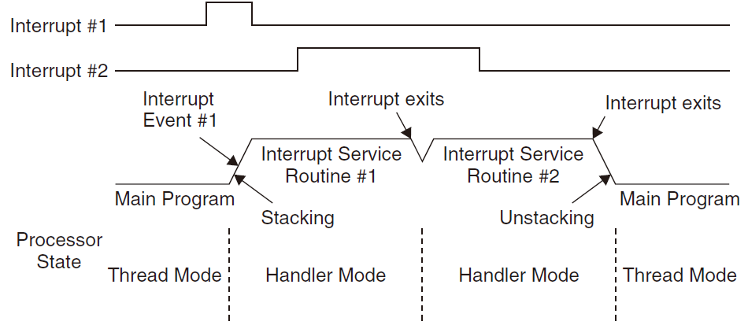
Tail-Chaining Interrupts
Used to improve interrupt latency:
When the processor is handling an exception, all other exceptions with the same or lower priority will be blocked (pended)
When the processor has finished executing the current exception handler, the un-stacking for this handler and the stacking for the next handler are skipped (reducing the latency of 12 cycles to 6)

Slide 60
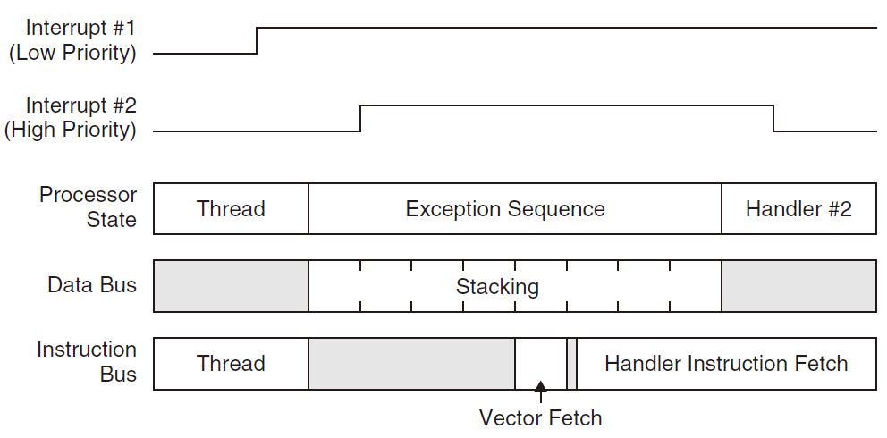
Late Arrival Exception Handling
Used to improve interrupt latency:
When an exception takes place and the processor has started the stacking process, if a new exception arrives with higher preemption priority, the late arrival exception will be processed first.

Slide 61
Faults Related to Interrupts
Stacking faults: a bus fault exception will be triggered or pended
Un-stacking faults: a bus fault exception will be triggered or pended
Vector fetch faults: the hard fault handler will be executed
Invalid return faults: If the EXC_RETURN number is invalid or does not match the state of the processor, the usage fault handler will be triggered or pended

